Slide 1


E-mail /
Message
Spam
Detector
Guided By:-
Prof. Brijesh Patel
Designed By :- Ujjwal Chauhan (12002040501074)

Slide 2
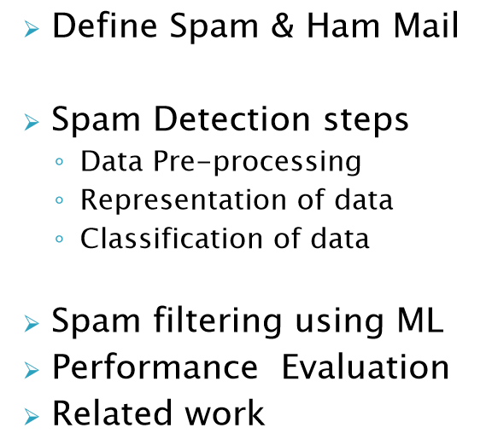
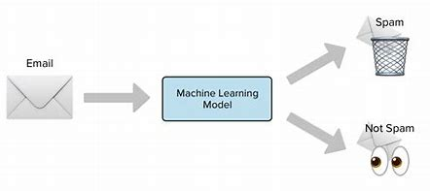
Outline : -
Things that is covered in this presentation;
[1]

Slide 3
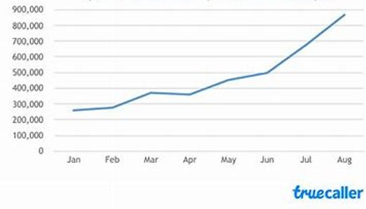
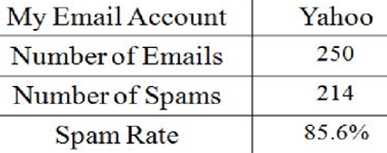
Objective : -
It is inconvenient , annoying and wasteful of computer recourses.
Statistics about Spam indicate that over 50% of all email in recent years is spam . Data from 2022 points to an average percentage of 47.3 %.
Why this topic is chosen for the presentation ;
[2]

Slide 4
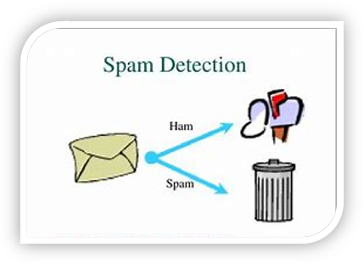
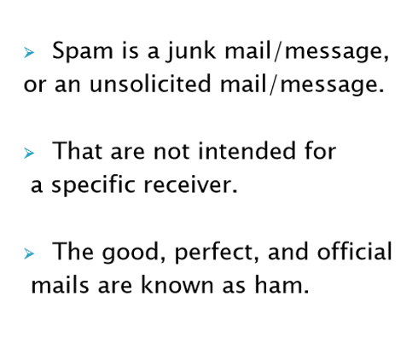
Introduction : -
What is SPAM Mail ?
[3]

Slide 5
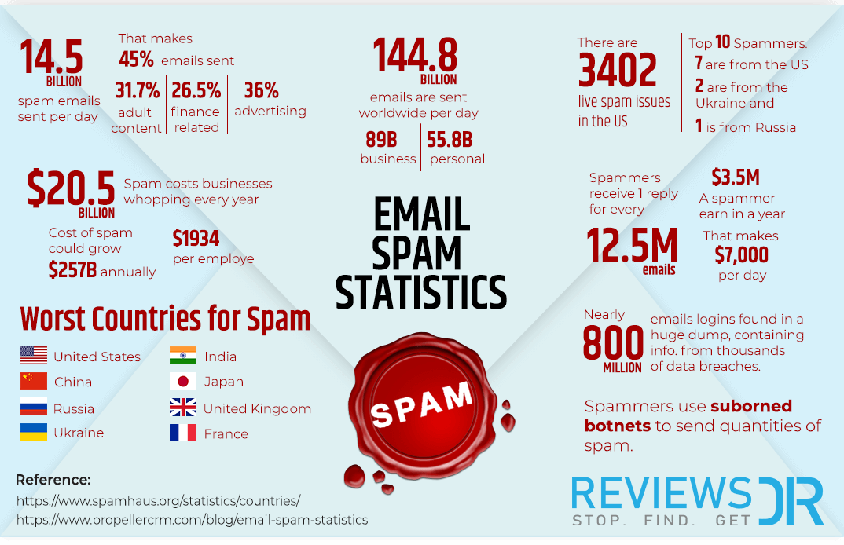

Slide 6
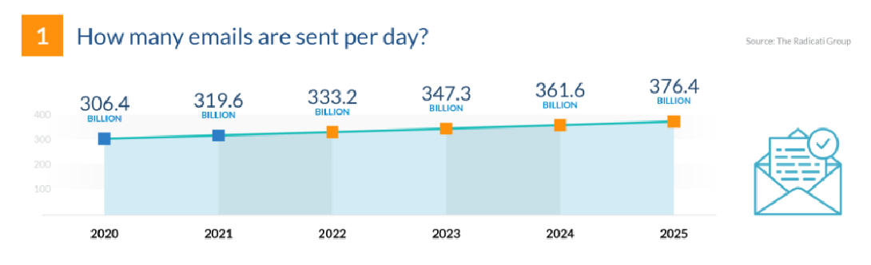
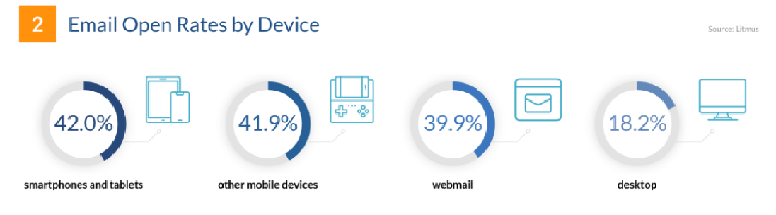

Slide 7

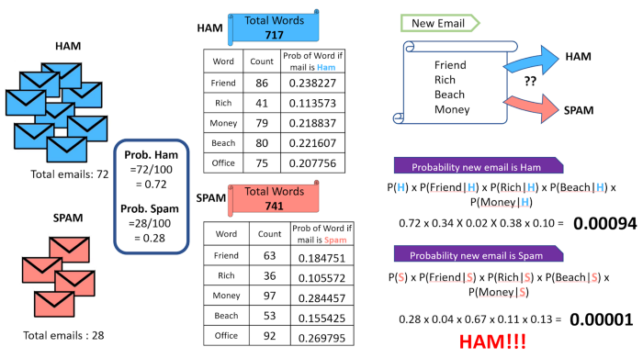
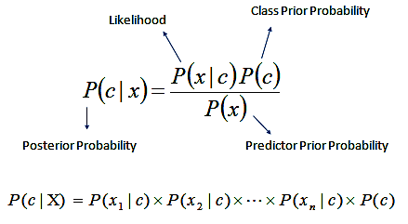
Method/Algorithm : -
Algorithm that is used in this project ;

Slide 8
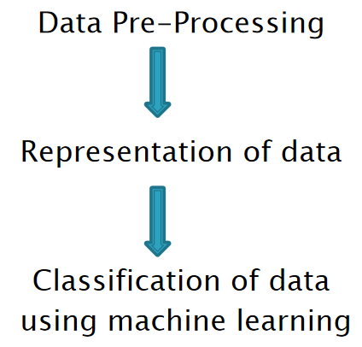
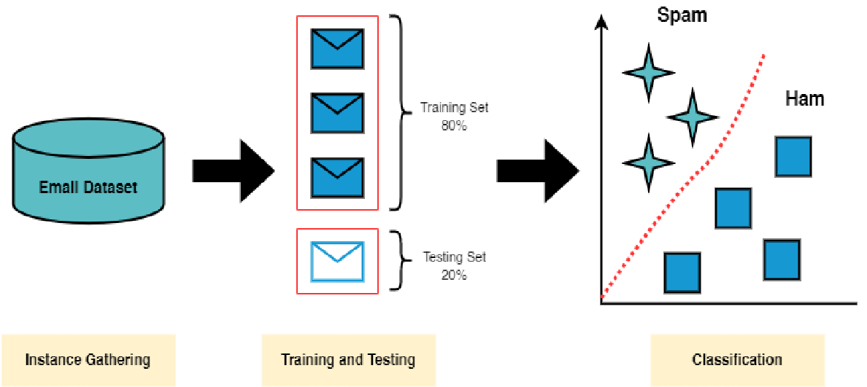
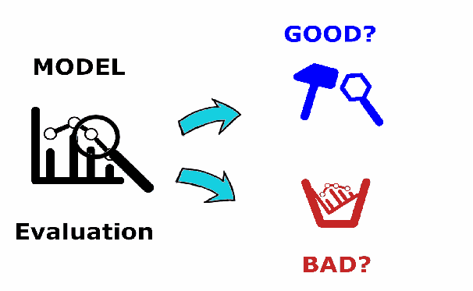
Implementation : -
Steps to be performed ;
[5]
[4]

Slide 9
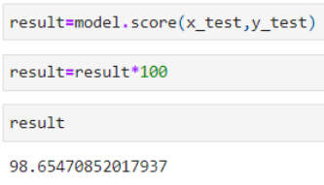
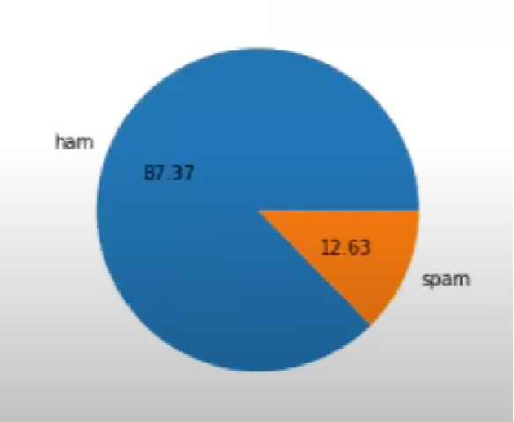
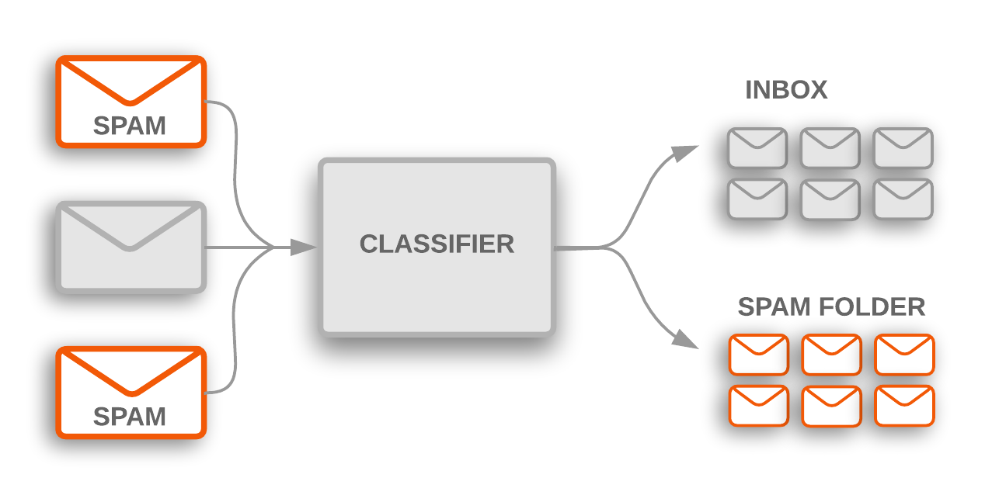
Results : -
Result / Accuracy that come by the model ;
-> From the Dataset;
->Examples are shown on next slide;
[7]
[8]

Slide 10
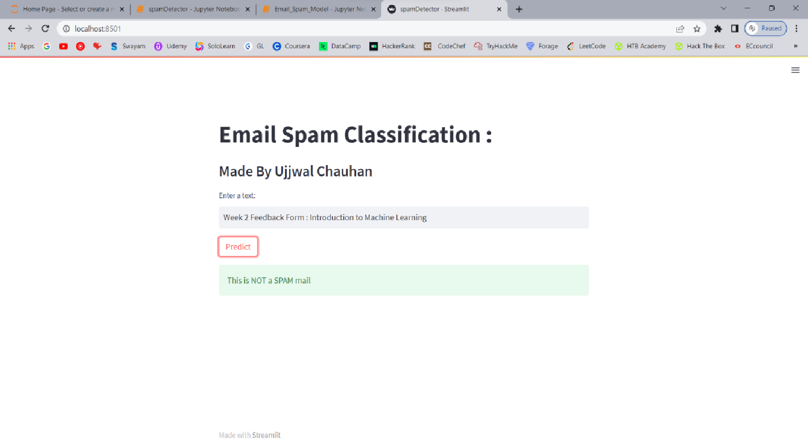
Conclusion : -
At last, what we had reached to conclude / Summary ;

Slide 11
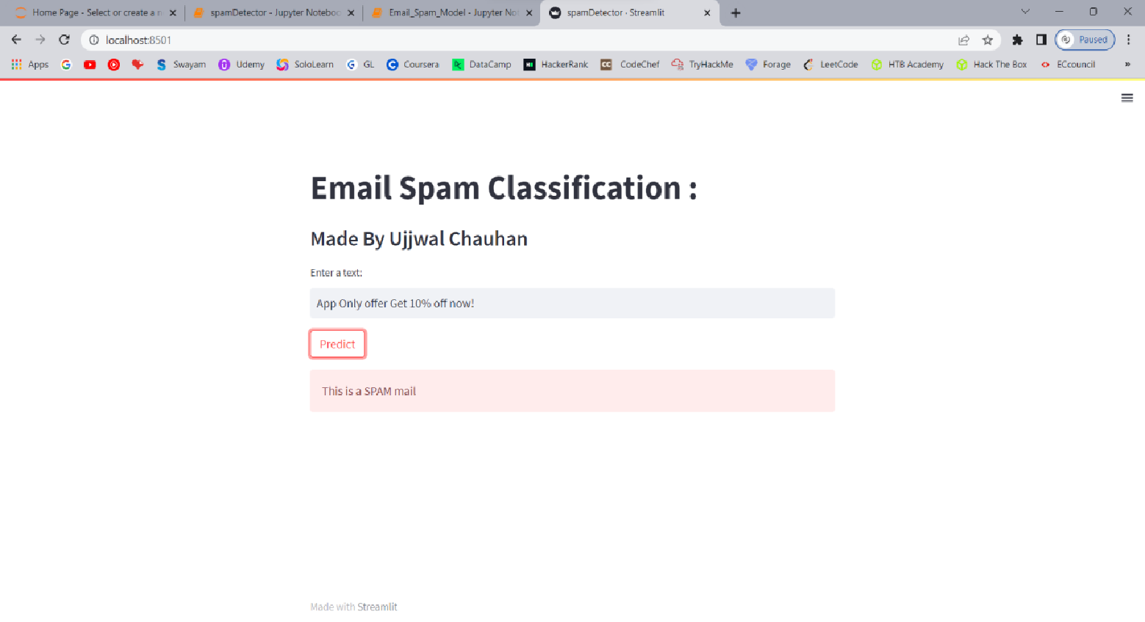

Slide 12
Five different Email classification techniques were identified-
Supervised ML
2) UnSupervised ML
3) Semi-Supervised ML
4) Content Based ML
5) Statistical ML
Most widely used “supervised machine learning” technique.
Conclusion : -
At last, what we had reached to conclude / Summary ;
Spam corpus dataset is the most commonly used datasets in classification.(Kaggle)
During the implementation, only text (messages) can be classified and score instead of domain name and email address. This project only focus on filtering, analysing and classifying message and do not blocking them.
Here, by applying NB algorithm we reach upto 98% accuracy.
-> From this project, it can be concluded that machine learning algorithm is one of the important part in order to create spam detection application. To make it more efficient, improvement need to be implemented in future.

Slide 13
Different Surveys : -
Author | Data base | Approach | Accuracy
Bassiouni, M. Ali & E. A. El-Dahshan | Spam base UCI data base | Data Classification using 10 Classifier | Random Forest -95.4% Naïve Bayes - 89.8% SVM - 91.8%
Diksha S. Jawale Ashwini G. Mahajan | Phish Tank Dataset | Spam Filtering using NB-SVM (ensemble learning) | NB – 95.78% SVM - 97.13%
Bassiouni M, Ali M, El-Dahshan EA. Ham and spam e-mails classification using machine learning techniques. Journal of Applied Security Research. 2018 Jul 3;13(3):315-31
Jawale DS, Mahajan AG, Shinkar KR, Katdare VV. Hybrid spam detection using machine learning. International Journal of Advance Research, Ideas and Innovations in Technology. 2018;4(2):2828-32

Slide 14
https://en.wikipedia.org/wiki/Spam_Classification (Google Search)
Build Email Spam Classification Model (Naive Bayes Classifier) (pykit.org)
Email Spam Classification | Kaggle [https://www.kaggle.com/datasets/balaka18/email-spam-classification-dataset-csv]
[1] https://www.google.com/url?sa=i&url=https%3A%2F%2Fnetcorecloud.com%2Ftutorials%2Fspam-filter%2F&psig=AOvVaw0Uluakt38dFIfmkj1_2DEt&ust=1681239001634000&source=images&cd=vfe&ved=0CA4QjRxqFwoTCKCG2L39n_4CFQAAAAAdAAAAABADr
[3] https://www.google.com/imgres?imgurl=https%3A%2F%2Fmiro.medium.com%2Fv2%2Fresize%3Afit%3A1400%2F1*Fm58r_RQ53sEHfwFa28LpA.png&tbnid=rVsIXQ5F_ohUyM&vet=12ahUKEwiI_vKX_p_-AhU3_zgGHcklBYkQMygMegUIARD1AQ..i&imgrefurl=https%3A%2F%2Fmedium.com%2F%40naveeen.kumar.k%2Fnaive-bayes-spam-detection
[2] https://www.google.com/imgres?imgurl=https%3A%2F%2Fcamo.githubusercontent.comHam-vs-Spam-Detection-Web-App&docid=3RbQvlA4npzCDM&w=920&h=400&q=spam%20detection%20photos&ved=2ahUKEwiI_vKX_p_-AhU3_zgGHcklBYkQMygBegUIARDdAQ
[4] https://www.google.com/imgres?imgurl=https%3A%2F%2Fmiro.medium.com%2Fv2%2Fresize%3Afit%3A749%2F0*j1wMZQ2je5P5DHvN&tbnid=GeAlDd9P3549PM&vet=12ahUKEwiI_vKX_p_-AhU3_zgGHcklBYkQMygSegUIARCBAg..i&imgrefurl=https%3A%2F%2Fmedium.com%2F%40alinatabish%2Fmachine-learning-techniques-for-spam-detection-in-email
[5] https://www.google.com/imgres?imgurl=https%3A%2F%2Fmiro.medium.com%2Fv2%2Fresize%3Afit%3A1400%2F0*SHZ7ehjxCaS7-VBp.png&tbnid=DcsgJGkCKNFtPM&vet=12ahUKEwjU7I_kgKD-AhWdzaACHb-VD9MQMygUegUIARCFAg..i&imgrefurl=https%3A%2F%2Fmedium.datadriveninvestor.com%2Fusing-natural-language-processing-for-spam-detection-in-emails
[6] https://www.google.com/imgres?imgurl=https%3A%2F%2Flh4.googleusercontent.com%2FWFmLk4zeHeLnAUHL9p4ePChAziudL8SX3yTHgmNhUNJXzGcHvnIEZc1SupmYN61imvLDK72Qa4vAhSlohtZeRT0EPCOBG9RaQCYI7MVhULVRuIJcWhMqGPYHEugLnhR72oMPkl4S&tbnid=o72AVtgW7T0XwM&vet=12ahUKEwjU7I_kgKD-AhWdzaACHb-VD9MQMyg8egQIARB2..i&imgrefurl=https%3A%2F%2Fwww.springboard.com%2Fblog%2Fdata-science%2Fbayes-spam-filter%2F&docid=RfJbYyV7BDE-2M&w=694&h=412&q=spam%20detection%20&ved=2ahUKEwjU7I_kgKD-AhWdzaACHb-VD9MQMyg8egQIARB2
[7] https://www.google.com/imgres?imgurl=https%3A%2F%2Fstorage.googleapis.com%2Fgweb-cloudblog-publish%2Fimages%2Fimage4_v2LFcq0.max-1200x1200.png&tbnid=Fm7ydGDtqEgtvM&vet=12ahUKEwjU7I_kgKD-AhWdzaACHb-VD9MQMygEegUIARDjAQ..i&imgrefurl=https%3A%2F%2Fcloud.google.com%2Fblog%2Ftopics%2Fdevelopers-practitioners%2Fhow-spam-detection-taught-us-better-tech-support&docid=L521DSn0QkPwJM&w=1200&h=600&q=spam%20detection%20&ved=2ahUKEwjU7I_kgKD-AhWdzaACHb-VD9MQMygEegUIARDjAQ
[8] https://www.google.com/imgres?imgurl=https%3A%2F%2Fassets-veritone-common.mkt.veritone.com%2Fwp-content%2Fuploads%2F2018%2F11%2F09110045%2FHow-to-train-a-spam-detector.jpg&tbnid=e7nx86mPW6l5bM&vet=12ahUKEwim4ajkgaD-AhUF93MBHduDDyYQMygPegUIARD6AQ..i&imgrefurl=https%3A%2F%2Fwww.veritone.com%2Fblog%2Fhow-to-train-a-spam-detector-with-a-97-accuracy-with-machine-box%2F&docid=ebqIuhQeSISsmM&w=1024&h=454&q=spam%20detection%20images&ved=2ahUKEwim4ajkgaD-AhUF93MBHduDDyYQMygPegUIARD6AQ
References : -
Thank You

